Slide 1








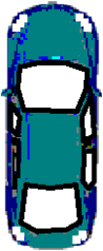

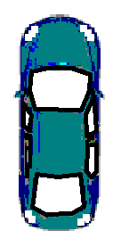
Square and cube roots
Task A: Square root
1) Match the square root of the perfect square with the correct answer.
6
2
9
7
15
2) Work out the missing numbers using your knowledge of perfect squares and square roots.
a)
b)
c)
100
4
16
36
3) An outdoor party has plot allocation of 100m² for all the guests. The party will have a kitchen/dining area, cake table, square bouncy castle and a car to power the bouncy castle. There are multiple solutions. The largest the castle can be is 100 - 4 - 18 - 10 = 68 so the closest perfect square is 64. The largest castle is 8 m by 8 m. This doesn’t leave enough space though so we need a 6 m by 6 m castle.
Each square is 1m² .
Cake table
kitchen/diner
Bouncy castle
Car
?
2 m
3 m
2 m
2 m
6 m
5 m
?

Slide 2












Square and cube roots
4) Only inserting perfect square numbers, fill in the missing gaps.
is closest to
b) is closest to
c) is closest to
64
81
144
Task B: Cube root
1) Which of the following will give an integer answer?
2) What is the closest integer to ?
Laura says “It is 6”
Jun says “It is 5”
Who is correct? Explain your answer.
6 ✕ 6 ✕ 6 = 216
5 ✕ 5 ✕ 5 = 125
216 is closer to 200 than 125. Therefore Laura is correct.
Mathematics in Education and Industry
v2.2

Slide 3




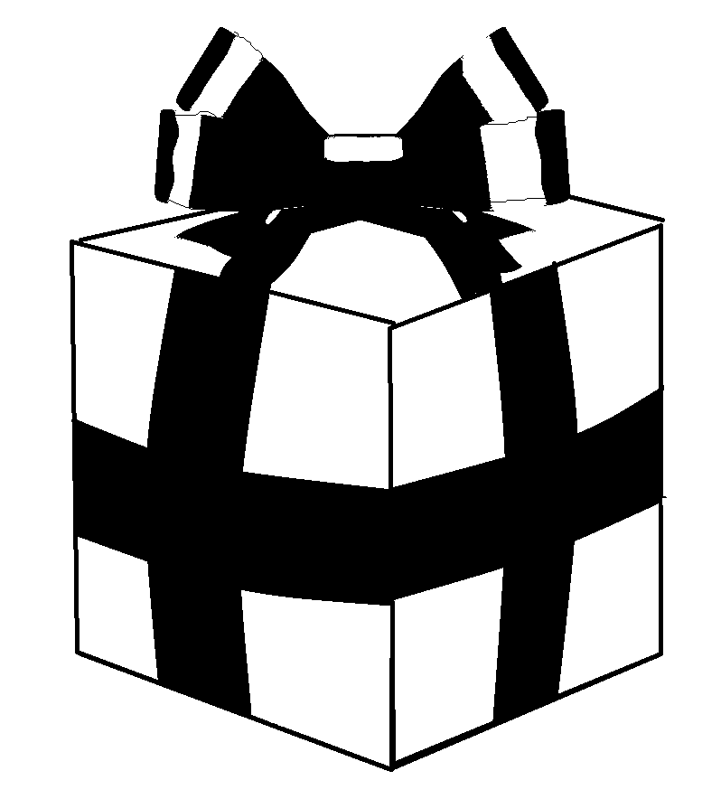

Square and cube roots
3) Work out the answers to the following using your knowledge of square and cube roots of perfect square and perfect cube numbers.
a)
b)
c)
d)
= 5 - 1
= 4
= 10 + 8
= 18
= 10 + 2
= 12
= 4 - 8
= -4
4) Izzy has puzzle cube gift for Lucas. The puzzle cube has a length of 4.5 cm. She needs to select the correct gift box. The gift boxes are also cubes.Which gift box is the best choice for the puzzle cube?
Explain your answer.
Volume = 1000 cm³
Volume = 512 cm³
Volume = 64 cm³
Length of gift box is 10 cm
Length of gift box is 8 cm
Length of gift box is 4 cm
Mathematics in Education and Industry

